Slide 1
Java 2 Enterprise Edition (J2EE)

Slide 2
Agenda
Introduction to J2EE
J2EE Framework
Support to J2EE of big software vendors
Software Architectures
Features and Concepts in J2EE
Sample J2EE Architectures

Slide 3
What Is J2EE?
Say simply, J2EE is:
  a suite of specifications for application programming interfaces
  a distributed computing architecture
  definitions for packaging of distributable components for deployment.
It’s a collection of standardized components, containers, and services for creating and deploying distributed applications within a well-defined distributed computing architecture.

Slide 4
When using J2EE?
J2EE targets at large-scale business systems
The software in the J2EE framework needs to be partitioned into functional pieces and deployed on the appropriate hardware platforms to provide the necessary computing power
J2EE provides:
  a collection of standardized components that facilitate software deployment
  standard interfaces that define how the various software modules interconnect
  standard services that define how the different software modules communicate.

Slide 5
Relate to J2SE
J2SE (Java 2 Standard Edition) is the core upon which J2EE is based
Use J2SE components and APIs in conjunction with the J2EE components and APIs to build your applications

Slide 6
Why using J2EE?
J2EE:
Define a number of essential services to develop enterprise-class applications
Provide infrastructure required to write enterprise-class applications: there are a bunch of different system-level capabilities to write distributed applications that are scalable, robust, secure, and maintainable
Define a set of containers, connectors, and components that can run on any number of J2EE-compliant implementations

Slide 7
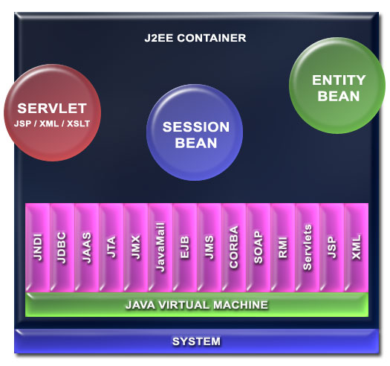

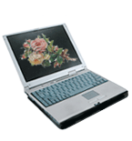

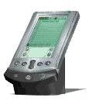
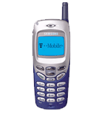

J2EE Framework
Java Technologies
External
Application
Notes:
JNDI: Java Naming and Directory Interface
JAAS: Java Authentication and Authorization Service
JTA: Java Transaction APIs
JMX: Java Management Extension
JMS: Java Message Service

Slide 8
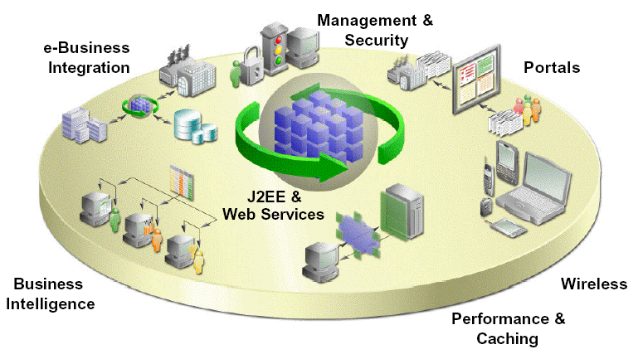
Oracle 9iAS Internet Application Server Enterprise Edition used by SCT for Banner
100% compliant
J2EE server
Oracle9i Application Server
http://www.oracle.com/ip/deploy/ias
Notes:
How many students know about Oracle?
SCT Banner: System & Computer Technology corporation
Banner: name of a software, a type of ERP for University

Slide 9

“WebSphere continues the evolution to a single Web services-enabled, Java™ 2 Enterprise Edition (J2EE) application server and development environment that addresses the essential elements needed for an on demand operating environment.”
  http://www-3.ibm.com/software/info1/websphere
IBM & Globus Project developing grid computing with JBoss and IBM WebSphere
  http://www-1.ibm.com/grid/grid_strategy.shtml
  http://www.javaworld.com/javaworld/jw-09-2002/jw-0906-grid.html

Slide 10
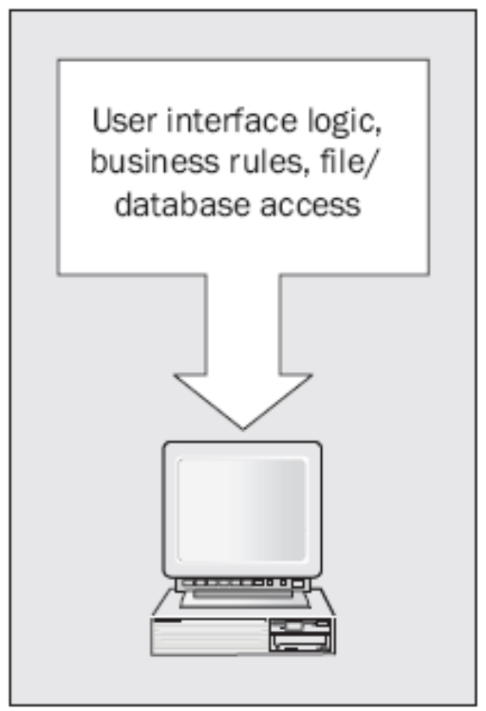
Single Tier Applications
Notes:
Tedious job
Difficulty in maintenance – Don’t know the code of other people

Slide 11
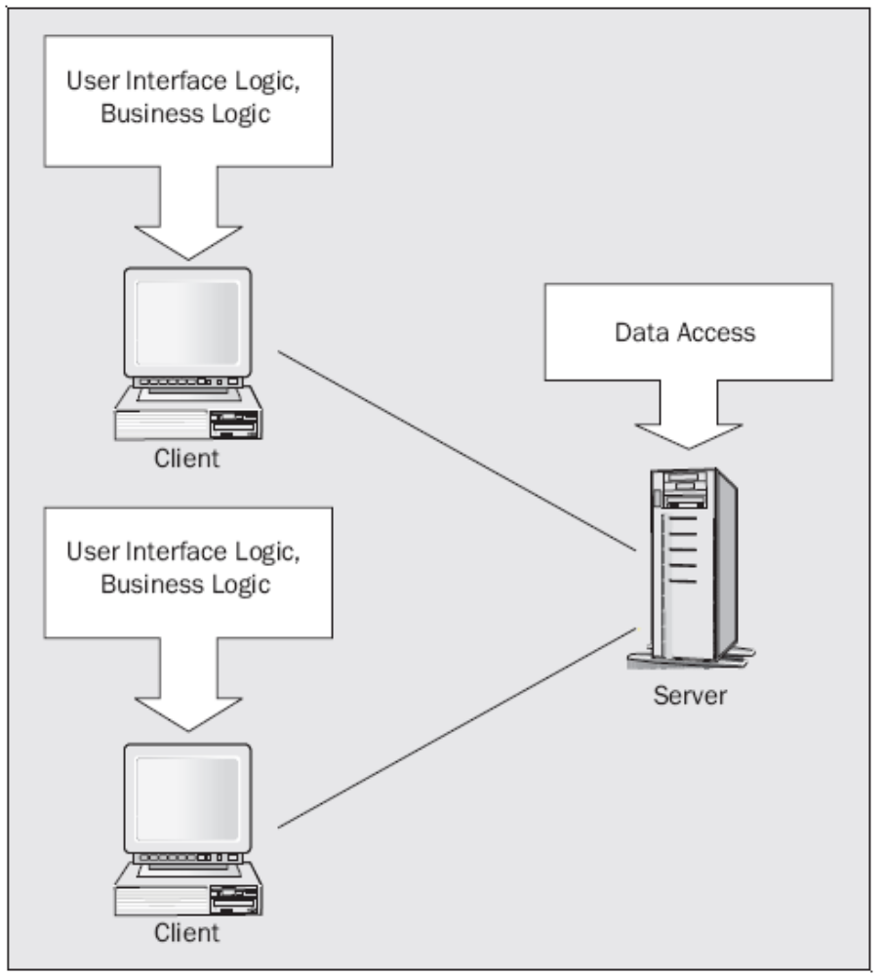
Client-Server Applications

Slide 12
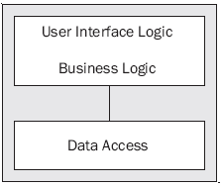
Two-Tier Architecture

Slide 13
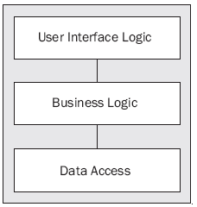
Three-Tier Architecture

Slide 14
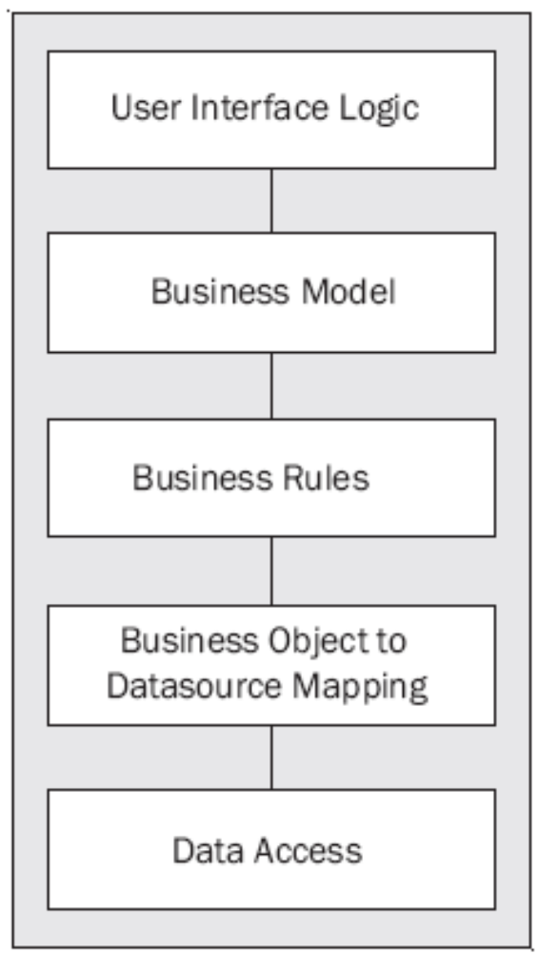
Multi-Tier Architecture
Notes:
Divide as much as possible, but for convenient purpose only
Maybe more than 5 layers

Slide 15
Vendor Independence
Java (including J2EE) is designed to run on all platforms (platform-independence)
The architects of J2EE has an open specification that can be implemented by vendors

Slide 16
Scalability
Changes in requirements → changes have to be made in software
The J2EE architecture provides much flexibility to accommodate changes as the requirements for throughput, performance, and capacity change
J2EE also supports clustering, connection pooling, and failover
Notes:
Scalability is one of foreseen features.

Slide 17
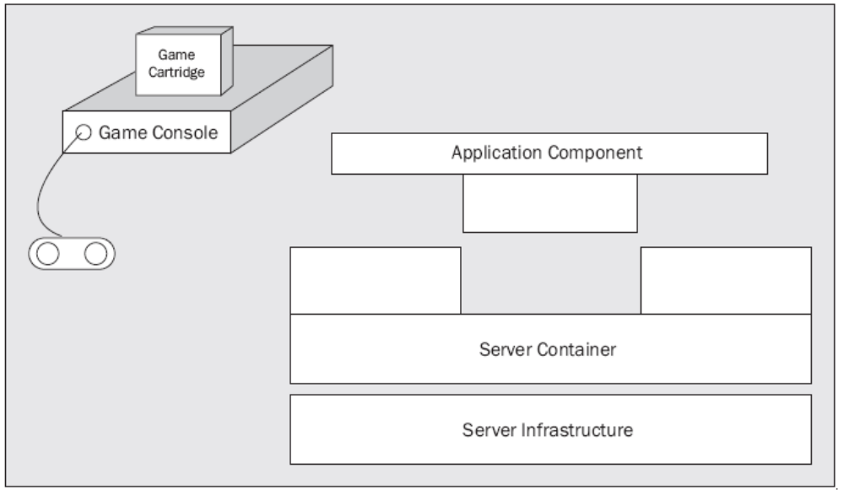
Containers
A central theme in the J2EE architecture
Notes:
Like sockets, they can be fit with each other

Slide 18
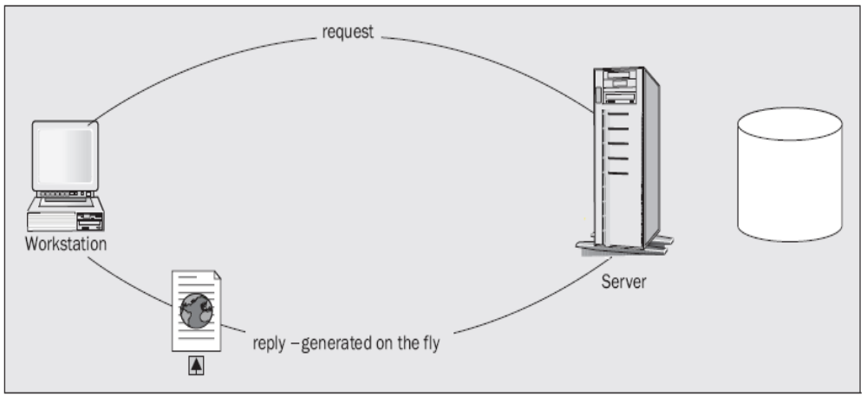
Java Servlets
Provide for dynamically generated content

Slide 19
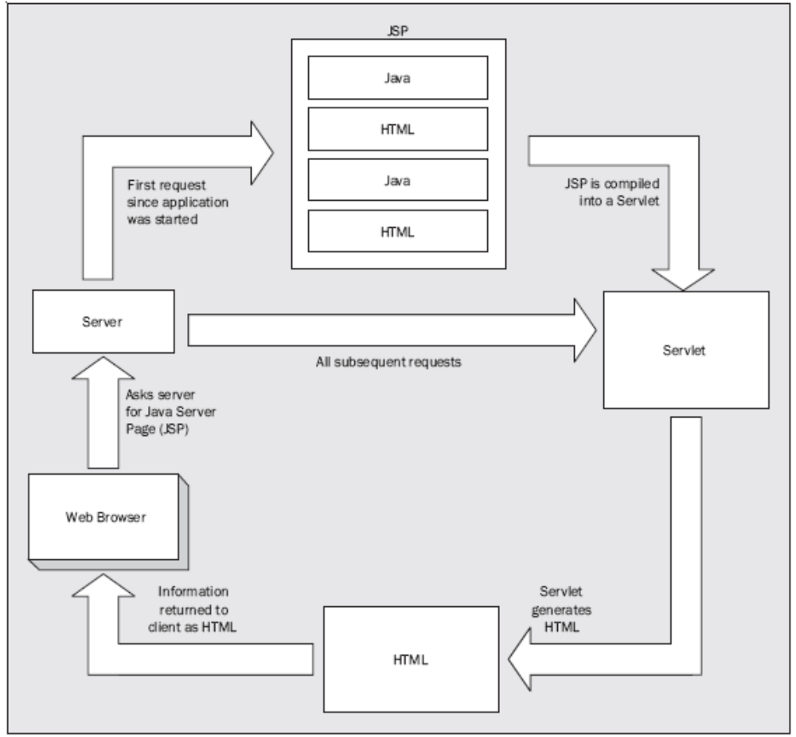
JavaServer Pages

Slide 20
Enterprise JavaBean (EJB)
Developed based on Remote Method Invocation (RMI)
EJBs are Java components that implement business logic. This allows the business logic of an application kept separate from the front-end applications that use that business logic
The J2EE architecture includes a server that is a container for EJBs
3 types:
  Session bean: maintain the state of sessions
  Entity bean: represent business objects
  Message bean: a component model for services that listen to Message Service messages
Notes:
Store information in object in application server rather than store it in client’s hard disk
Entity bean: represent a business entity (it can be usually map with an entity in database)

Slide 21
XML Support
Extensible Markup Language (XML) is a significant cornerstone for several core techniques in J2EE
Two 2 APIs to process XML:
  Document Object Model (DOM): a tree-oriented model
  SAX (Simple API for XML): a stream-based event-driven processing model
Java API for XML Binding (JAXB): mapping XML to and from Java classes

Slide 22
Web Services
A web service is a software function that:
  Has its interface be public
  Can be called by other services or programs
A business service is often designed and implemented by a web service
Web services become a new method to develop softwares
Service-Oriented Architecture (SOA): a software architecture that is based on web services
Notes:
Web service is foundation of cloud computing, grid computing

Slide 23
Transaction Support
J2EE—and EJB in particular—provides substantial transaction support.
The EJB container provides built-in support for managing transactions, and allows the developer to specify and modify transaction boundaries without changing code.
Where more complex transaction control is required, the EJB can take over the transaction control from the container and perform fine-grained or highly customized transaction handling.

Slide 24
Security
J2EE provides strong built-in security mechanisms
Authorization in J2EE is based on roles of users of applications

Slide 25
Sample J2EE Architectures
Several different architectures for different types of applications, but some commons
n-Tier Architecture is intended to solve:
  High cost of maintenance when business rules change
  Inconsistent business rule implementation between applications
  Inability to share data or business rules between applications
  Inability to provide web-based front ends to line-of-business applications
  Poor performance and inability to scale applications to meet increased user load
  Inadequate or inconsistent security across applications

Slide 26
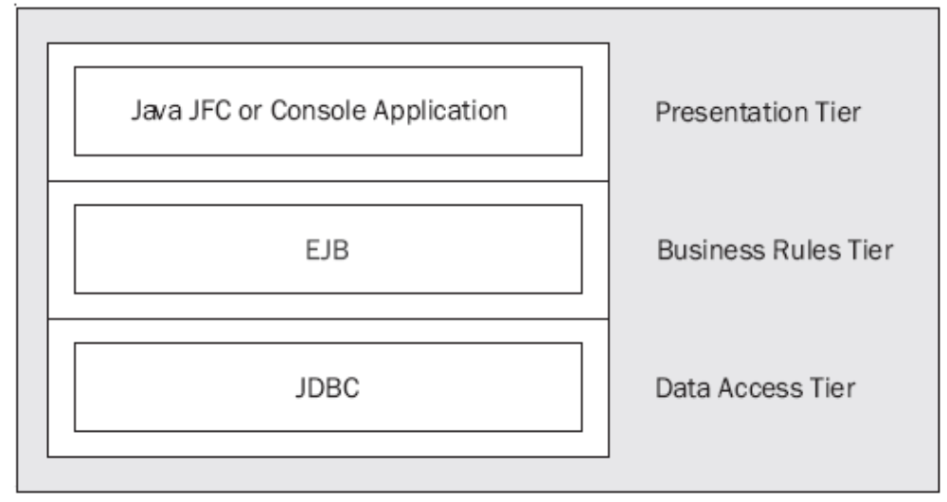
Application Client with EJB
The client application is built as a stand-alone (JFC/Swing or console) application.
The application relies on business rules implemented as EJBs running on a separate machine.

Slide 27
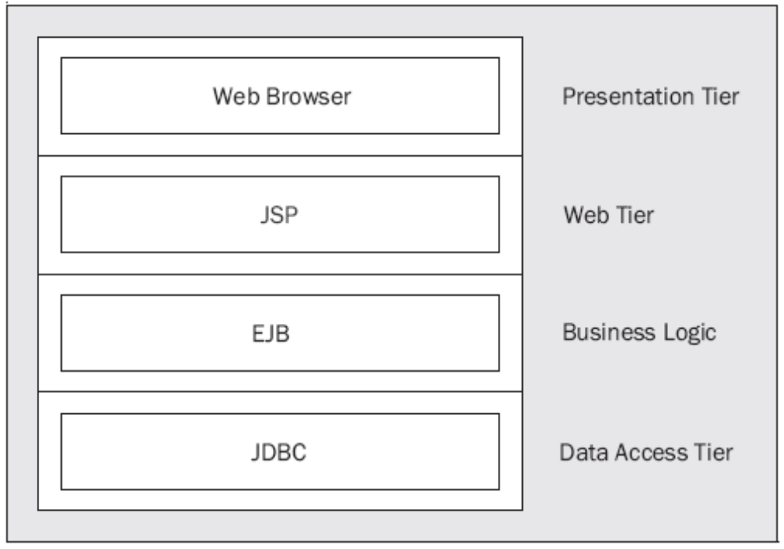
JSP Client with EJB
The client in this architecture is a web browser.
JavaServer Pages access business rules and generate content for the browser.

Slide 28
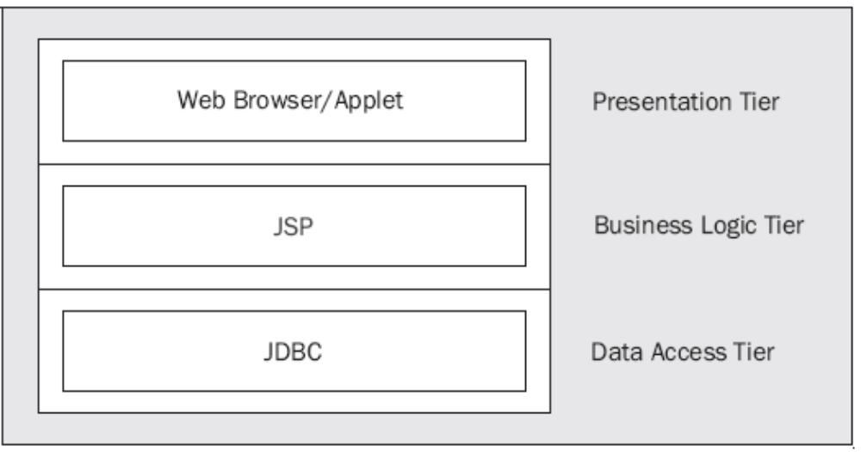
Applet Client with JSP and Database
The client application is a web browser, but in this case a Java applet is used within a web page to provide a more interactive, dynamic user interface for the user. That applet accesses additional content from JSPs.
Data is accessed from the JSP via the JDBC API.

Slide 29
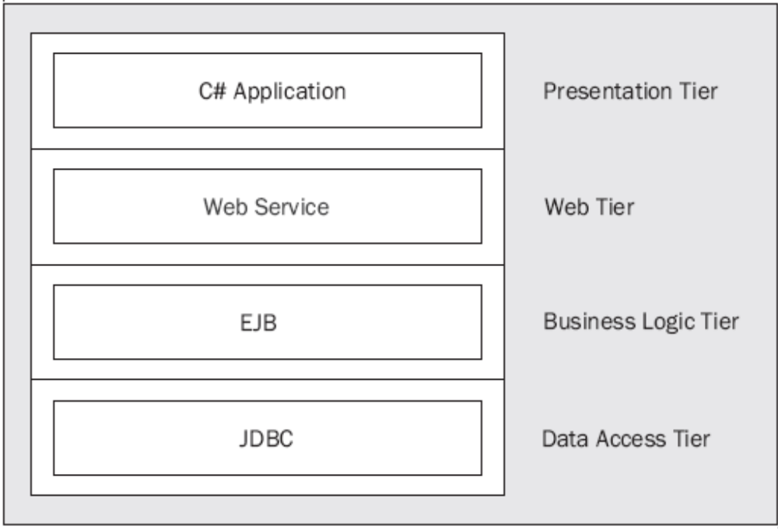
Using Web Services for Application Integration
A client application implemented in C# accesses data from a web service implemented in Java.

Slide 30
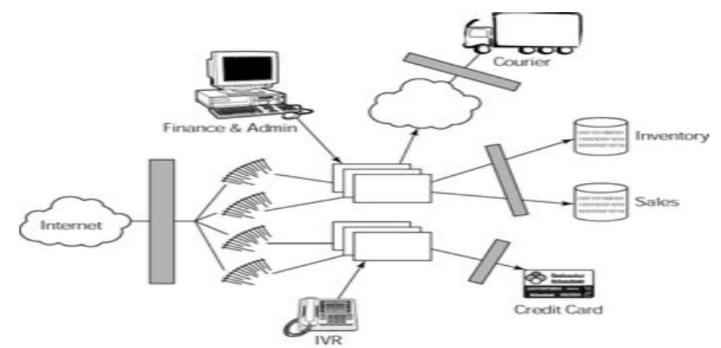
Sample J2EE Application 1 -
B2C E−commerce Web site
Web−Page Generation | Middleware | Database Server | Operating System
ASP | COM/DCOM | Usually SQLServer, but could be Oracle/Informix/Sybase | Microsoft
Servlet/JSP | EJB or CORBA | Oracle/Informix/Sybase | UNIX/Microsoft
CGI | CORBA | Oracle/Informix/Sybase | UNIX
Notes:
Introduce some real application

Slide 31
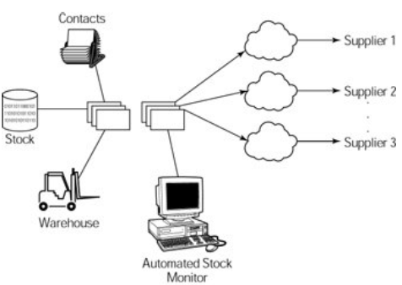
Sample J2EE Application 2 -
An Inventory System in B2B E−commerce
API | Use
EJB | Abstraction of business logic.
XML | Exchange of parts information and orders.
JNDI | Customer and supplier directory handling.

Slide 32
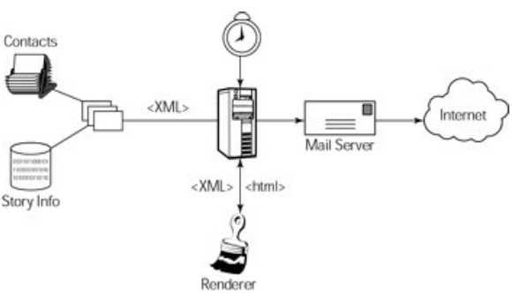
Sample J2EE Application 3 -
Monthly electronic newsletter
API | Use
JavaMail | Interface to e−mail system.
XML | Stores formatted message information.
JDBC | Extracts address information directly from the database.

